Slide 1
Source Control Fundamentals

Slide 2
Some code to use for context
We will use a hypothetical calculator app for the basis of discussing source control and what problems it solves.

Slide 3
What we will need
Shell + Git = Cmder
Something to scaffold and build our program with = dotnet sdk
A text editor/IDE = Visual Studio Code

Slide 4

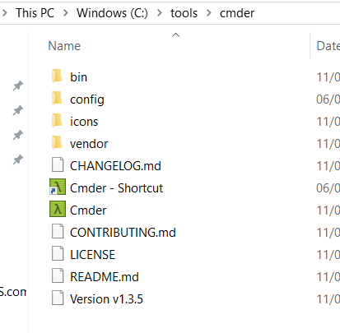
Lets do a Diagnostic
Do you have cmder?
- this icon in your start bar?
- usually installed here

Slide 5
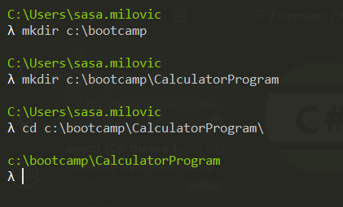
Worlds simplest example
Create a place to work in
Notes:
The type is intentional

Slide 6
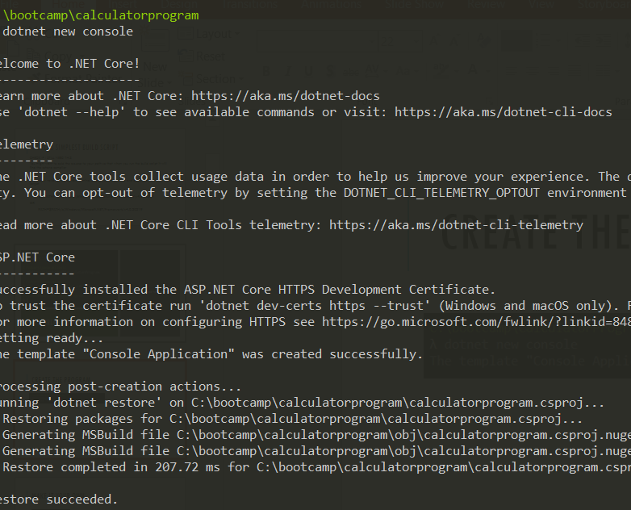
Create the program

Slide 7
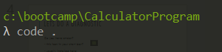
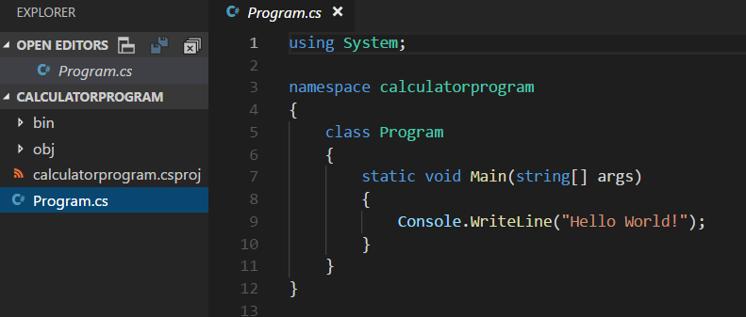
Make it your own

Slide 8
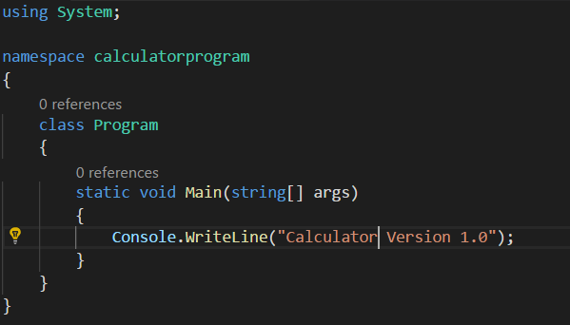
Notes:
The typo is intentional

Slide 9
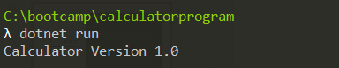
Run it

Slide 10

Imagine THIS situation…

Slide 11

Its 1970...
Notes:
It’s the 70s
Your calculator app is going to be sold on floppy disks
You might have several version of your software at clients at any point in time
You intend to support and maintain all versions for the next few years
You have a team of several people that might need to work on the calculator program at the same time

Slide 12

Problems to solve
Have a history of who did what
Be able to go back to an earlier version of the code in case things go wrong
Multiple Version
Conflicting changes between versions
Ability to promote changes between versions

Slide 13
Ideas?

Slide 14
Definition of Version Control
A component of software configuration management, version control, also known as revision control or source control, is the management of changes to documents, computer programs, large web sites, and other collections of information.

Slide 15
What problem does VC solve
Allows multiple developers to collaborate on the same code base by
Providing a mechanism to centrally store code
Retrieve and modify the code
Providing a readable audit of how the code has changed
Providing a mechanism to deal with multiple parties changing the same files
Providing a way to return to a previous state
Notes:
Different products tackle these in differing ways.

Slide 16
Quick History of Source Control Software
In 1972 SCCS was designed to solve a specific set of problems
Source code takes up too much space because it is repeated in every version.
Passing fixes from one version to other versions is difficult.
It is hard to acquire information about when and where changes occurred.
Finding the exact version which the client has problems with is difficult.
Sounds like our exact problem!

Slide 17

Using git like it’s 1972
Notes:
Lets create a local git repo to see how we could solve some of our 1970s problems
download Cmder portable
https://github.com/cmderdev/cmder/releases

Slide 18
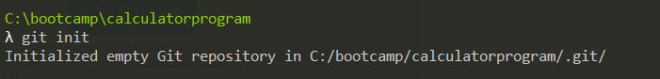
Lets create a repository
Open the calculator directory in a cmder console window

Slide 19
What did that do?
Creates an empty git repository in the current directory and creates a .git directory

Slide 20
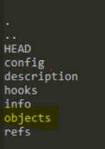
What do all these things mean?
For now we will focus on the most important git concepts related to versioning files and directories
In order to understand these we need to discuss git objects
TYPE:
ls –la .git\

Slide 21
Git objects
Git is known as a content addressable file system
This is means it’s just a key value store
A key value store, when asked to store some value or object, gives you a key (a lookup value/reference) to use to later retrieve that object.
Git stores certain types of objects as values and these are important to understand

Slide 22
Git objects
Blob
File contents
Tree
Represents a directory and contents, has pointers to other trees and blobs
Commit
A pointer to a tree (top level tree)
A pointer to previous commit
Some information about the commit (message, author, committer, timestamp)
Notes:
Add a picture

Slide 23
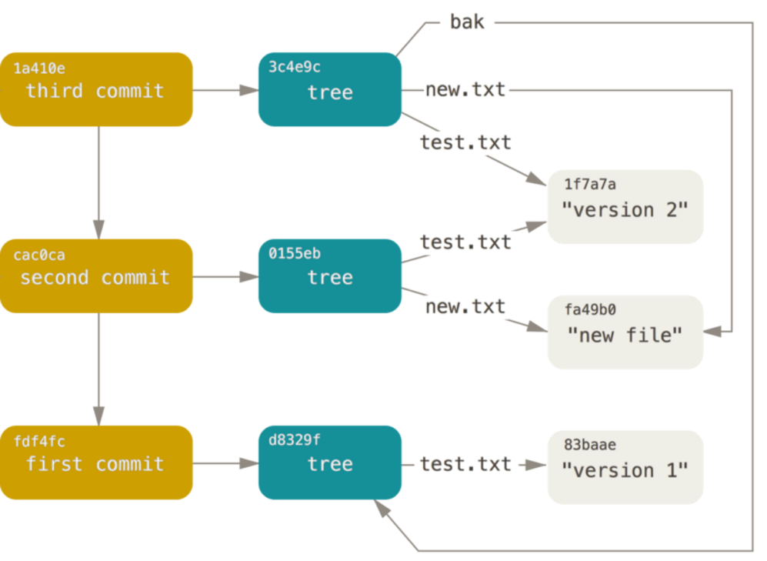
Git objects in pictures
Notes:
Add a picture

Slide 24
Adding my app to the source control
Which objects should exists after I commit?
Determine the type and number of objects

Slide 25
Adding my app to the source control
2 Blobs
1 Tree
1 Commit

Slide 26
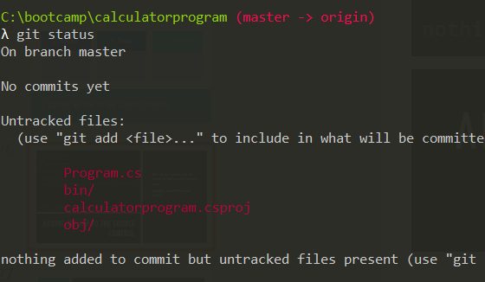
Adding my app to the source control
Git status – shows me the status of the current working copy
Should I commit the bin/ (or obj) folder?

Slide 27
Checking in binaries
The answer is usually no, but why?
Could manually add each file, but I’m way to lazy
How do I tell git to just ignore certain types of files or directories?
Notes:
There are three ways to ignore files –
Excludes
global ignore
local ignore
The other two are homework

Slide 28
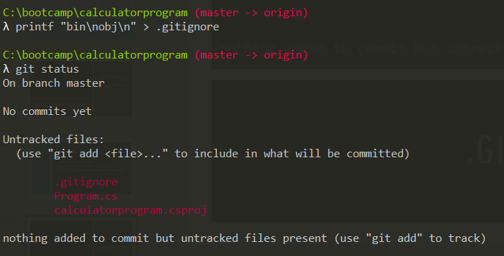
.gitignore file
A special file that tells git to ignore stuff
Notes:
Create the .gitignore file with the content "bin"
This can be different patterns for excluding files etc

Slide 29
Ok so how do I create my commit/tree/blobs?
Add to the index so the tree objects can be created
lower level commands exists we will use the simplest one - git add
git add . stages all changes to the index
Notes:
Lower level git commands are very useful for understanding the internals of git better

Slide 30
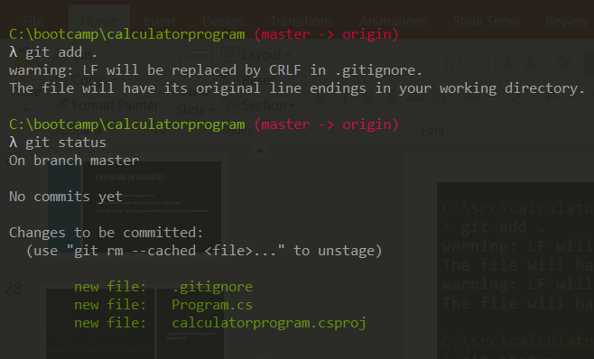
Staging the commit
Staging only creates some blobs. But you don’t have a commit or tree objects yet.
git status will now show you what you have staged as "changes to be commited"

Slide 31
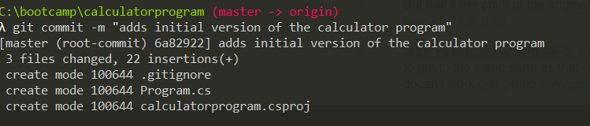
CREATE A COMMIT
Run the git commit and use the –m flag to add a commit message

Slide 32
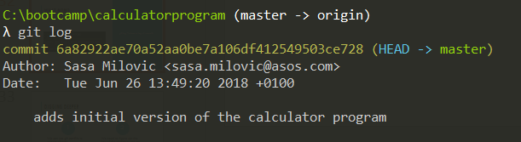
What now?
git log – shows a log of commits
Notes:
What about git status?

Slide 33
Digging deeper
We can use git cat-file to inspect objects
1
We need to figure out the key of the objects to use git cat-file
2
Notes:
git cat-file for the curious!
Pass it key (SHA1) value
switches
-p (prints contents)
-t describes the type

Slide 34
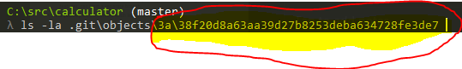
Digging deeper
Keys are based on SHA1 hashes of the file contents
In the git objects directory
the first two characters are used for a directory name
the rest are the name of the file within that directory
Notes:
All the long weird alpha numeric strings we see are SHA1 hashes (which act as the keys of the objects)

Slide 35
Problems to solve
Have a history of who did what
Be able to go back to an earlier version of the code in case things go wrong
Multiple Version
Conflicting changes between versions
Ability to promote changes between versions

Slide 36
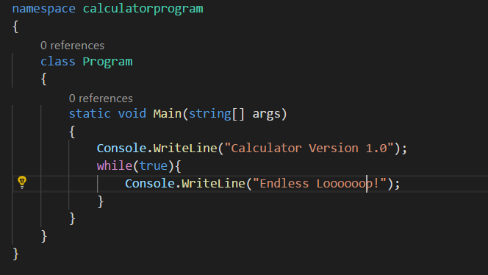
Going back when things go wrong

Slide 37
Commit your new feature
Commit this new feature (can you remember which commands you need to use?)

Slide 38
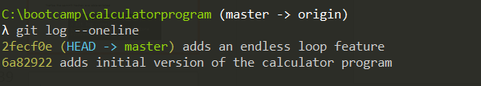
Commit your new feature
When you view the log you should see two commits
To make the commits easier to read use –oneline
Notice the commit hashes are abbreviated

Slide 39
Lets fix this
Could edit the code and commit - or be lazy and let the git do it
Use the revert command and provide the hash of the commit
You can use the shortened form

Slide 40
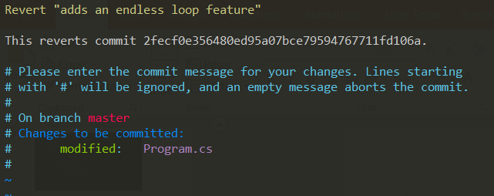
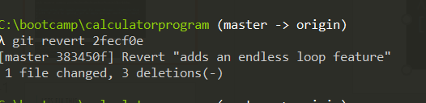
Lets fix this
Notes:
Commit message dialog will pop up
:x to save and exit
It will commit there after

Slide 41
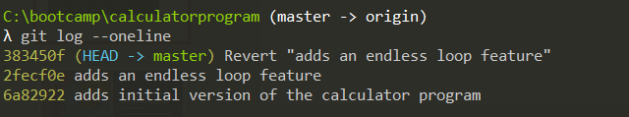
Lets fix this

Slide 42
Problems to solve
Have a history of who did what
Be able to go back to an earlier version of the code in case things go wrong
Multiple Version
Conflicting changes between versions
Ability to promote changes between versions

Slide 43
Branches?
Like as in a tree?
Or more like graph theory
Allows two (or more) parallel version of the files/software to exist at the same time
Usually changes need to be incorporated (merged) across branches

Slide 44
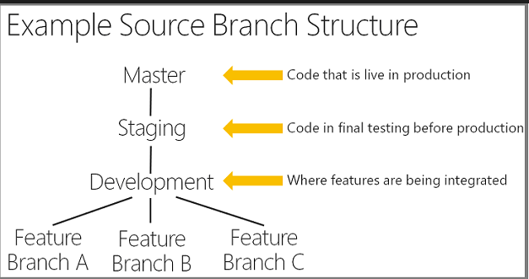
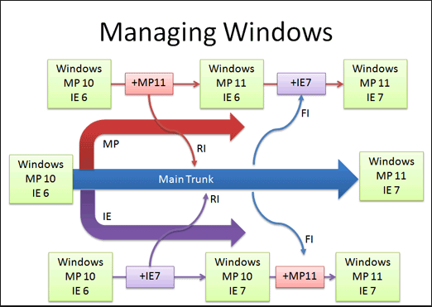
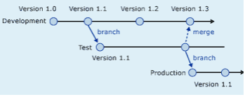
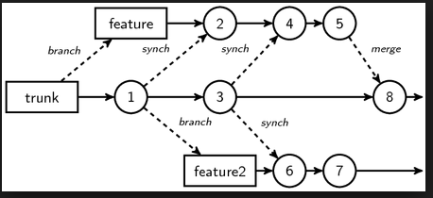
Branches?
Many different approaches and strategies
There should (and usually is) a specific reason for adopting a strategy and should always be justified
A topic to itself with plenty of differing opinions
Undeniable truths
They introduce complexity
The longer they exist and diverge, the harder the merge
(fondly referred to as merge parties)

Slide 45
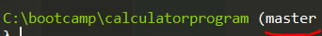
Git and Branches
You are already working on a branch called master

Slide 46
Git and Branches
One of gits selling points is how it treats everything as branch which makes a little easier to work with them
This also helps explain some of the other things in the .git folder

Slide 47
Types of Ref(erence)s
Branch
Is a named reference to a commit
Can change which commit it points at
HEAD is the reference to the current branch of your working copy
HEAD will change every time you commit to point to the new commit

Slide 48
A hypothetical branching model
Lets create a branch per version
Git branch <name>
(these are actually more correctly called forks)
Switch to the branch to update the version we print in Calculator.cs
Git checkout <name>
I’m lazy, there must be a faster way
git checkout –b <name>

Slide 49
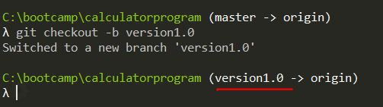
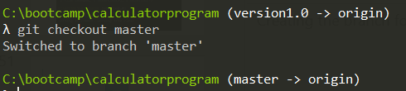
Notes:
Creating the branch for version 1, and going back

Slide 50
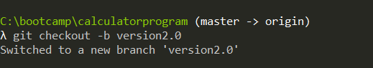
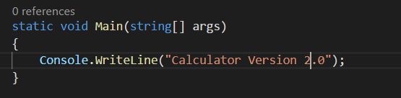

Slide 51
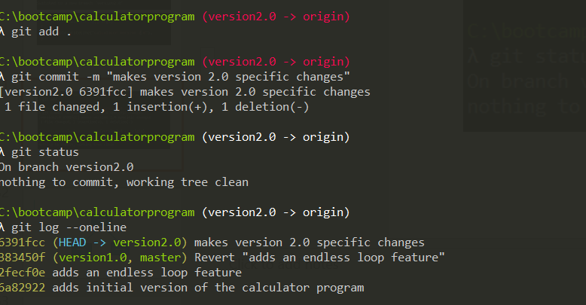

Slide 52
master
version1
version2
Notes:
What we think this might look like conceptually

Slide 53
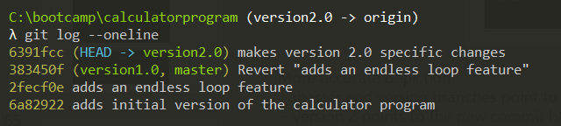
master
383450f
version1
6391fcc
version2
Notes:
More accurate depiction
- master and version branches point to ocd910c commit
- version 2 points to the new commit b8d89d0

Slide 54
Make a change to version 1
Try and go to version 1 of the software and add a new statement that prints “HELP FOR VERSION 1”
Mini Cheatsheet
- git checkout <branchname>
- git add <filename> / git add . (adds all changed files)
- git commit -m “<commit message>”
- git status
- git log –oneline
Notes:
Lets expand it more by adding a help docs to version 1 of the software
After this which commit does the version branch ref point at?

Slide 55
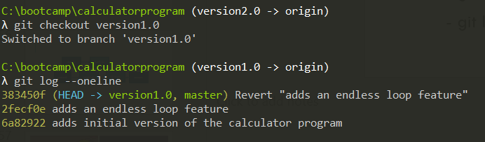
Notes:
Lets expand it more by adding a help docs to version 1 of the software
After this which commit does the version branch ref point at?

Slide 56
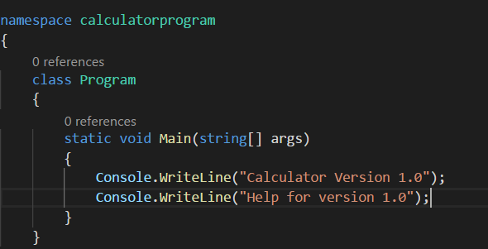
Notes:
Lets expand it more by adding a help docs to version 1 of the software
After this which commit does the version branch ref point at?

Slide 57
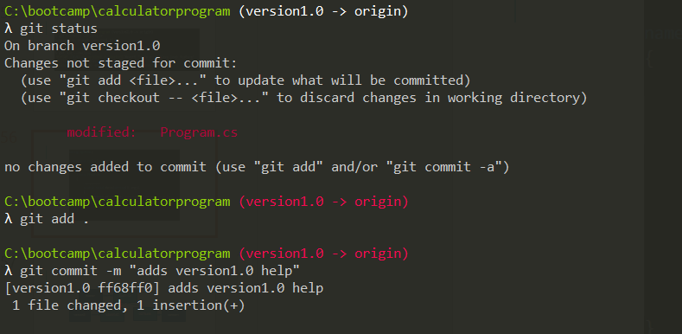

Slide 58
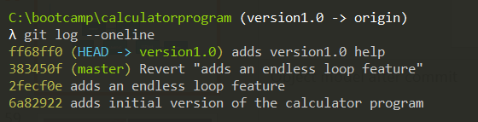
master
383450f
version2
6391fcc
ff68ff0
version1
Notes:
Object model after commit

Slide 59
Problems to solve
Have a history of who did what
Be able to go back to an earlier version of the code in case things go wrong
Multiple Version
Conflicting changes between versions
Ability to promote changes between versions

Slide 60
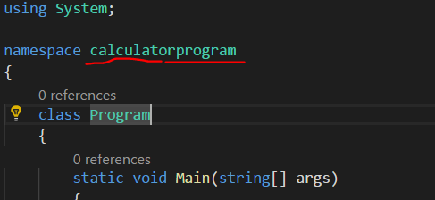
Lets fix that NAMESPACE in version 1 and 2
We will go with fix in master, then merge to specific versions
Notes:
Add a diagram to make this more clear

Slide 61
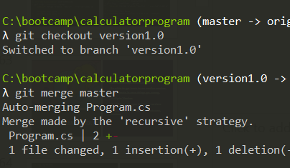
Merge MASTER to v1 and v2
Switch to each branch and do the following
git merge master

Slide 62
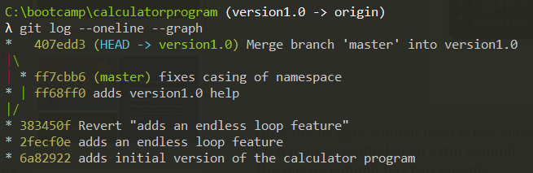
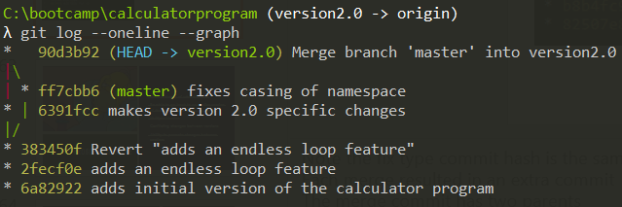
Visualise the merge
Switch between the branches and look at the log using the –graph option
Notes:
Note the fix type commit hash is the same
Each merge resulted in an extra commit
The merge commit has two parents

Slide 63
Problems to solve
Have a history of who did what
Be able to go back to an earlier version of the code in case things go wrong
Multiple Version
Conflicting changes between versions
Ability to promote changes between versions

Slide 64
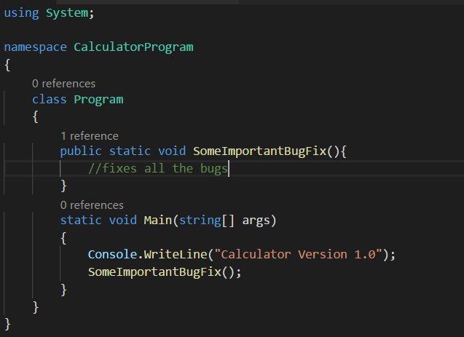
When conflict arises
In the master we make an important security bug fix

Slide 65
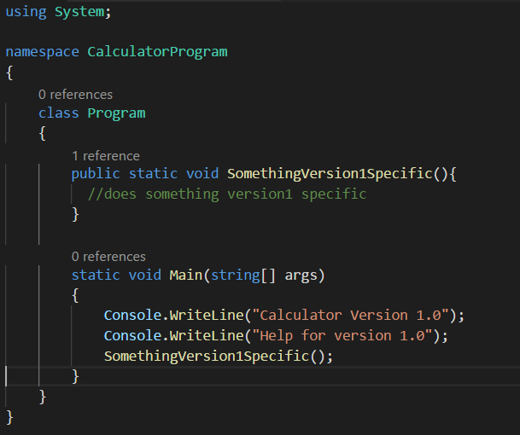
Meanwhile in version 1.0
Notes:
What's the problem that's going to happen?

Slide 66
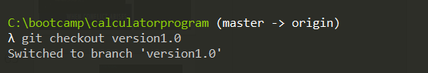
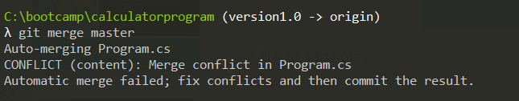
What happens when we merge?

Slide 67
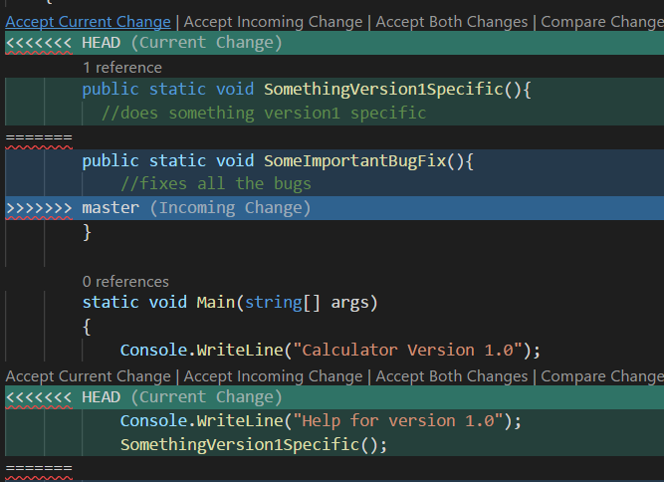
Lets open the file!

Slide 68
IT TIME FOR A Merge party!
Diffing and mergetools

Slide 69
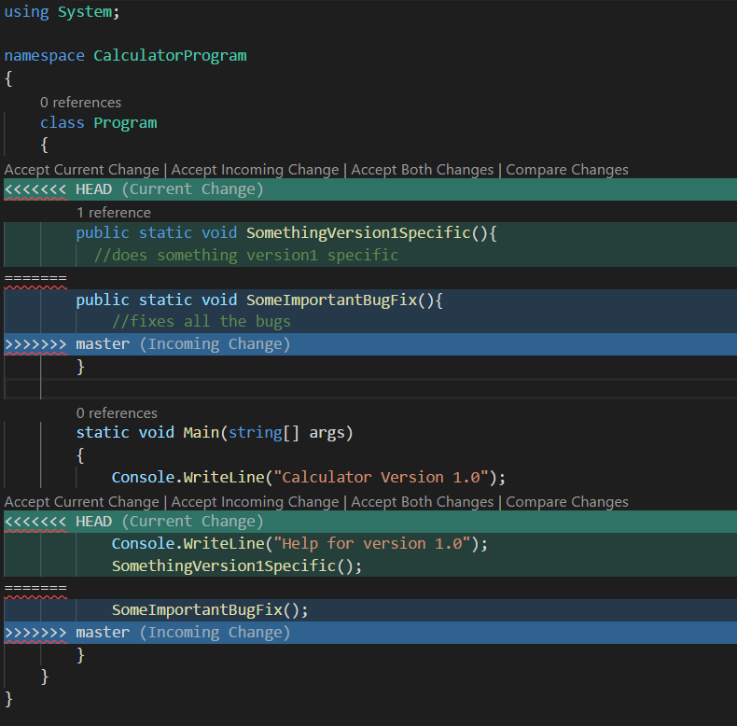
DISCUSS

Slide 70
Vs code BASIC MERGE
Not easy to see exactly what the common base looks like, and what changes were made side by side

Slide 71
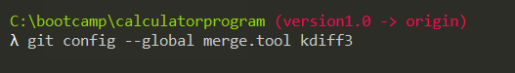
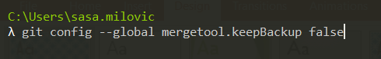
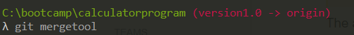
Setting up a more advance diff option

Slide 72
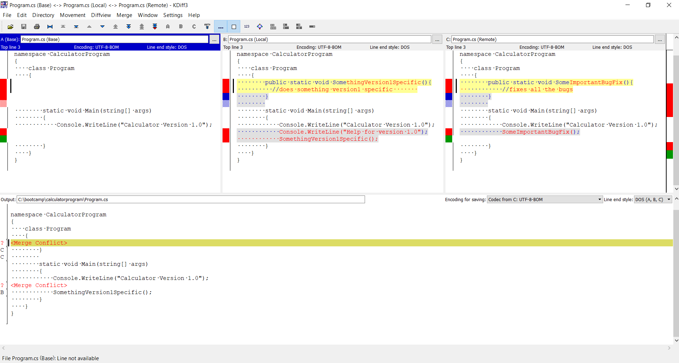

Slide 73

WHAT IS THIS MADNESS?

Slide 74
State before either changed
(BASE)
State in master
(REMOTE)
State before merge
(LOCAL)
Current state of the file

Slide 75

After closing mergetool

Slide 76

Commit the merge

Slide 77
Problems to solve
Have a history of who did what
Be able to go back to an earlier version of the code in case things go wrong
Multiple Version
Conflicting changes between versions
Ability to promote changes between versions

Slide 78


The next generation (86)
2nd Gen - CVS – Concurrent Versions System (1986),
A client–server architecture
a server stores the current version(s) of a project and its history
clients connect to the server in order to "check out" a complete copy of the project,
clients work on this copy and then later "check in" their changes.

Slide 79
Source Control Today – Rise of the DVCS
Distributed means no “real” central repository
GIT Linus’s replacement for BitKeeper
Mercurial - GIT’s evil twin

Slide 80
Advantages
You can work without needing to be connected to the central server,
Making it a whole lot faster

Slide 81

Disadvantages
But does this mean it’s more complex, because every copy of a repository is kinda like a branch that needs to be merged back to the “shared repository”?

Slide 82
So how do I share this so other people can help?
Lets create a central repo that we all sync with
01
Lets use Github for this!
02
This is usually referred to as a remote
at ASOS we would use TFS to host our remote
Notes:
Remote repositories are versions of your project that are hosted on the Internet or network somewhere

Slide 83

How do I know which remotes I have?

Slide 84
Creating a remote
If you don’t already have a github account set one up now
Once you are done we will got and create a remote repository
Then we will push our local repo to the remote

Slide 85


Slide 86


Slide 87

Add a remote!
Create a remote, called origin, that points to git@github.com:milodotnet/calculator.git
Push the commits from my local repo to the remote, and set it as the upstream (-u) – this sets this as the remote upstream for argumentless commands (e.g. git pull), origin gives the name of the remote, and master the name of the branch

Slide 88


Lets see which remotes I have now

Slide 89
Types of Ref(erence)s
Remotes
Read only
HEAD will never point to it so you cant change it by committing

Slide 90

Git cloning
This creates a local repo based on a remote and include setting up the remote

Slide 91
Lets start collaborating
Split into groups of three
Your task is to add two operations to the calculator program, add and subtract, and a main input loop
You want to divide these task up amongst each of you
What’s the best way to do this?
Try this using feature branches, or not, up to you!
Notes:
Hand out some git cheat sheets

Slide 92

How to add collaborators to github

Slide 93

Further reading
https://git-scm.com/book/en/v2

Slide 94

Microsoft’s Contributions
Source Safe (1995)
Lock based
No central server
Prone to corruption
TFS(2000ands)
Second foray into source control
Had a central serval
Was lock based (but changed)
Still exists today (even at ASOS!)
TFS Online supports hosting git repos
Notes:
For lols

Slide 95
References
https://en.wikipedia.org/wiki/Version_control
https://en.wikipedia.org/wiki/Source_Code_Control_System
https://en.wikipedia.org/wiki/Interleaved_deltas
http://docs.oracle.com/cd/E19504-01/802-5880/6i9k05dhp/index.html
https://en.wikipedia.org/wiki/Concurrent_Versions_System
https://simpleprogrammer.com/2017/01/16/software-developers-know-source-control/

Slide 96
References
https://stackoverflow.com/questions/2304087/what-is-head-in-git
https://git-scm.com/docs/git-init
http://eagain.net/articles/git-for-computer-scientists/
https://help.github.com/articles/ignoring-files/
https://stackoverflow.com/questions/6866838/what-should-be-in-the-git-description-file
https://git-scm.com/book/en/v2/Git-Internals-Plumbing-and-Porcelain
https://git-scm.com/book/en/v2/Git-Internals-Git-Objects
https://git-scm.com/book/gr/v2/Customizing-Git-Git-Hooks
https://git-scm.com/book/en/v2/Git-Internals-Git-References
https://git-scm.com/docs/git-push
https://git-scm.com/book/en/v2/Git-Basics-Working-with-Remotes

